Slide 1
Case study: How does a bike-share navigate speedy success?
Presented by – Aaman Kamal
Last updated- 10/09/2025

Slide 2
About the company
In 2016, Cyclistic launched a successful bike-share ofering. Since then, the program has grown to a fleet of 5,824 bicycles that are geo tracked and locked into a network of 692 stations across Chicago. The bikes can be unlocked from one station and returned to any other station in the system anytime.

Slide 3
Agenda
1) Problem Statement
2) Research Objective
3) Data Overview
4) Analysis and Findings
5) Recommendations

Slide 4
Problem Statement
Cyclistic’s nance analysts have concluded that annual members are much more profitable than casual riders. Although the pricing flexibility helps Cyclistic attract more customers, Moreno believes that maximizing the number of annual members will be key to future growth. Rather than creating a marketing campaign that targets all-new customers, Moreno believes there is a solid opportunity to convert casual riders into members. She notes that casual riders are already aware of the Cyclistic program and have chosen Cyclistic for their mobility needs.

Slide 5
Research objective
How annual members and casual riders differ from each other.
Why casual riders would buy a membership, and how digital media could affect their marketing tactics
Design marketing strategies aimed at converting casual riders into annual members.

Slide 6
Data overview
1) This dataset is Cyclistic’s historical trip data, directly provided by them.
2) In this analysis we use previous 12 months of Cyclistic trip data.
3) The original data is shared as a bike.csv files.
4) The twelve files corresponds to a single month of a year.

Slide 7
Analysis and findings
There are 55,97,030 Total customers from which 20,55,252 are casual riders, whereas 35,41,778 are members.
We can see that members rider are more than casual riders.
Row Labels | Sum of Count
casual | 2055252
member | 3541778
Grand Total | 5597030

Slide 8
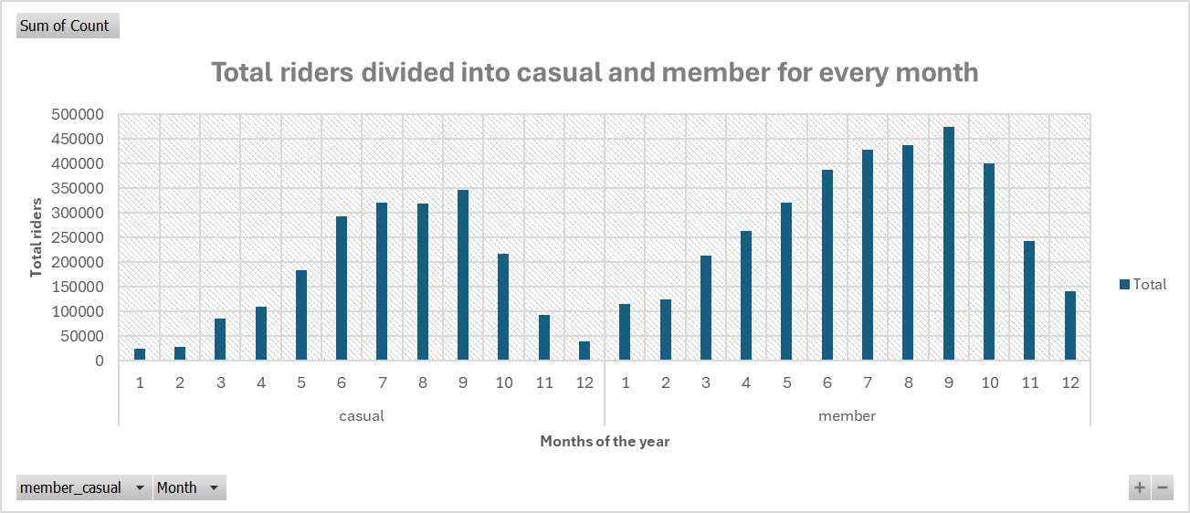
Rider pattern across the months of the year
In this chart we can see that the peak season for both casual and member rider is from May to October.
This shows that customer are seasonal riders, at summertime the ridership reaches to peak, whereas in winter season it drops drastically.

Slide 9
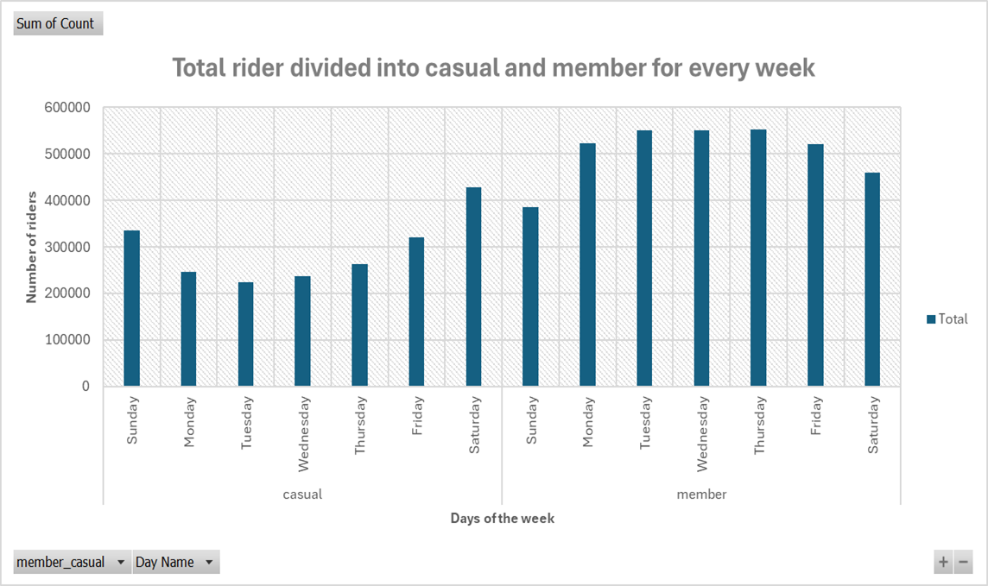
Rider pattern across the days of the week
In this chart we can see that casual rider, mostly rides at the weekends, where as the member rides on the weekdays.
This shows that most of the member riders are office worker, or students who uses it as a mode of transport to reach their offices or institutes.
Whereas the casual rider seems like they are using bikes at weekends for traveling purpose.

Slide 10
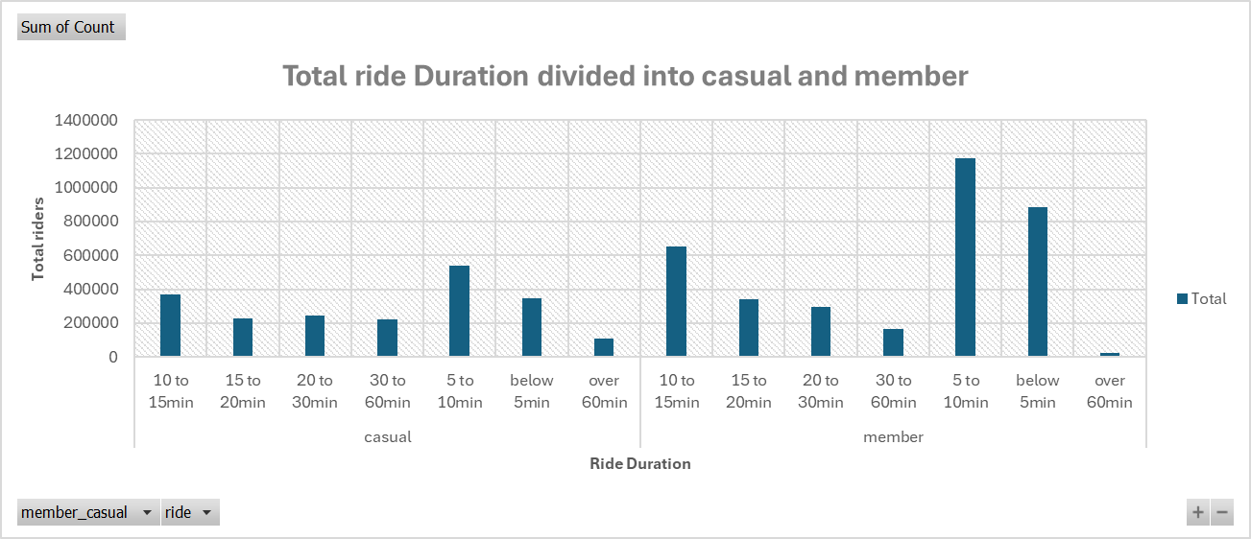
Ride Duration of casual and members
Above analysis showing that both casual and member rider have similar ride duration
Majority of rides are finished under 15 minutes, only few goes past 60 minutes.
This shows that majority riders are not using this services for long distances.

Slide 11
Casual vs members
casual
members
They are using bikes mostly at weekends for shopping’s and travelling.
Because they mostly use bike for weekends, they found annual membership non beneficial.
At winter season due to cold weather, they prefer car instead of bikes to commute,
They use bikes to reach their office or institutes.
Because they are using bikes for the weekday, they found annual membership beneficial.
At winter season due to cold weather the ridership drops significantly while having the membership.

Slide 12
Why casual rider are not upgrading
1) The first issue is, majority of casual rider are not using bikes for daily purpose, therefore they feels like membership is not beneficial for them, instead they are sticking for a single day pass for weekends.
2) The second issue is that the annual membership is for whole year, but due to cold weather they are not going to use bikes for 5 months, which feels like waste of money for them.
3) The third issue is that they are taking long trips, majority of the trips are under 15 minute, due to which the integration of bikes into their lives is very less, due to which they don’t feel to buy annual membership.

Slide 13
Recommendation
Company can introduce some kind of winter discount to annual members, so that casual rider become comfortable in buying annual membership, they will not feel like paying when not using bikes in winters.
Or in place of winter discount, they can offer half-yearly plans to the people who doesn't want to ride in winters.
They can change the costing of their plans in such a way that it feels like membership is more beneficial that casual, they can reduce per/km rate for membership as compared to casual.

Slide 14
The end

